Slide 1
Machine learning Mini-project: stratified k-fold cross validation
Paul-Luis Gronwald
Institute for Geodesy and Photogrammetry

Slide 2
Structure
Introduction to k-fold cross-validation
Challenge of k-fold CV
Stratification
Implementation in scikit learn
Variations on Cross-Validation
Advantages and disadvantages

Slide 3
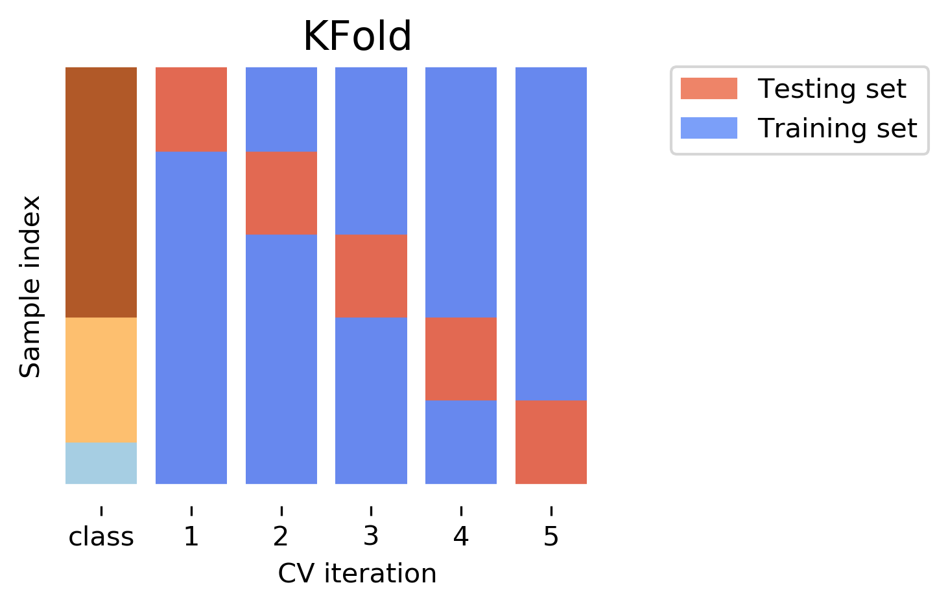

Introduction to k-fold cross-validation
Cross-validation estimates the skill of (different) machine learning models
Evaluation with limited data samples
Splitting Data in $k$-folds →train- and validationset
Validation set
Training set

Slide 4
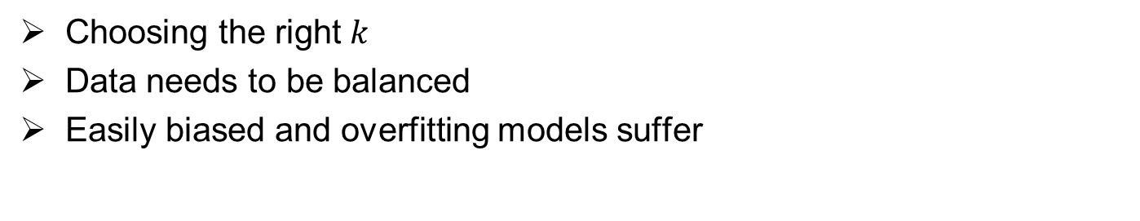
Challenge of k-fold CV
Choosing the right $k$
Data needs to be balanced
Easily biased and overfitting models suffer
class 2
class 1
train
k=3
valid
k=50
…
Notes:
minority classes
Models which tend to training instances arn‘t weight according to their classvalue

Slide 5
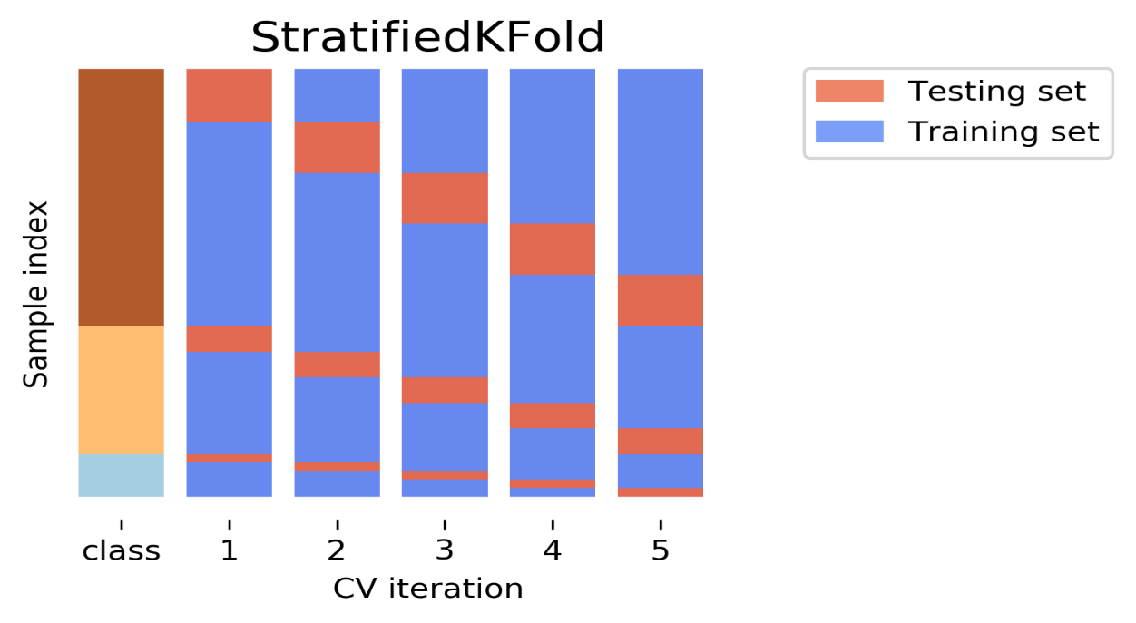
Stratification
Representing each class
Coutering imbalance whilst training and testing
Can be used for regression
Less variant CV-Score
Validation set
Training set
Notes:
The intuition behind this is based on the bias of most classification algorithms. They tend to weight each instance equally which means overrepresented classes get too much weight.
Regression: binning all the samples according to k and then using a similarity score

Slide 6
Implementation in scikit learn
sklearn.model_selection.train_test_split → well known
→ **option: stratify = [class-labels]
sklearn.model_selection.StratifiedKFold → automatic relabeling → y = ["Happy", "Sad"] to y = [1, 0]

Slide 7



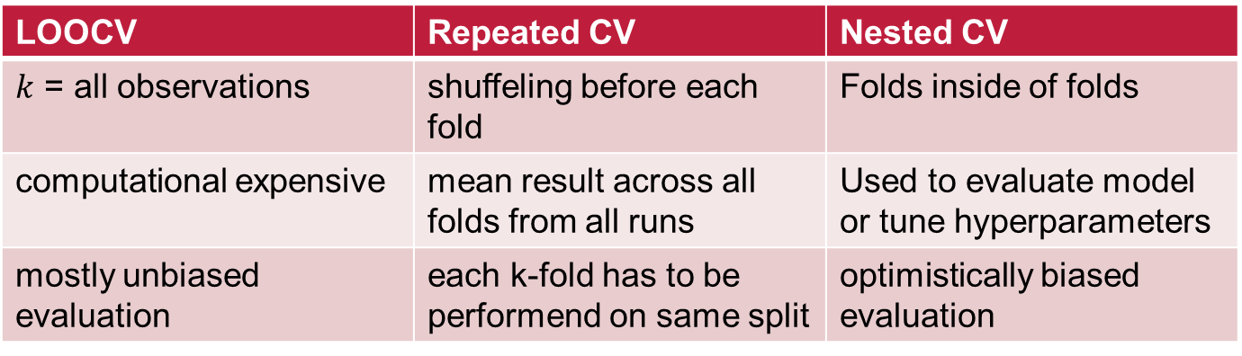
Variations on Cross-Validation
LOOCV | Repeated CV | Nested CV
$k$ = all observations | shuffeling before each fold | Folds inside of folds
computational expensive | mean result across all folds from all runs | Used to evaluate model or tune hyperparameters
mostly unbiased evaluation | each k-fold has to be performend on same split | optimistically biased evaluation
Notes:
LOOCV models is a more robust estimate of model performance as each row of data is given an opportunity to represent the entirety of the test dataset-> DONT use on small dataset
Repeated : A single run of the k-fold cross-validation procedure may result in a noisy estimate of model performance -> easy models eg linear
Nested : hyperparameter search does not have an opportunity to overfit the dataset as it is only exposed to a subset of the dataset provided by the outer cross-validation procedure.

Slide 8
Advantages and disadvantages
stratified k-fold CV
pro | con
Countering bias | Not needed if each class has equal weight
Good for use in small datasets | Rare classes (N<k) can not be represented in all folds
Notes:
not so important for an algorithm that weights each class equally

Slide 9
References
github.io/ (Figures on Page 3 and 5)
machinelearningmastery.com/.
stackexchange.com
https://www.reddit.com/ (Figures on Page 7)
scikit-learn.org/
scikit-learn.org/train_test_split

Slide 10
Challange of k-fold CV
Attract the audience using nice visualization
Avoid putting a lot of text in one slide
Use equation editor for writing equations
Put caption for each image
Add reference (with hyperlink) to the images which you took from somewhere else
Use slides animation if necessary, but do not use it too much
If necessary add sections to your presentation
Use consistent font and font size (view: slides master may help)

Slide 11
About your topic
In which libraries is implemented. For example in Scikit-learn?
Is there a code on the web for that? For example on GitHub?
Some images from your code outputs

Slide 12
Compare your topic with similar methods/topics/
Write about:
Advantages
Disadvantages
When it should be used
When it should not be used

Slide 13
Some notes
I may use/share this presentation later. Please let me know if you do not agree.
You should deliver a folder containing:
One .pptx and its .pdf version
One .ipynb file which contains your implementation
Folder name template: MiniProject_WiSe2020_Topic_YourName
For example: MiniProject_WiSe2020_kNN_MehdiMaboudi

Slide 14
References
Add references which you used here
Put a hyperlink for each reference
You can add some sources as further reading for more details which you did not cover them

